Slide 1
Power and Performance Tradeoffs for Visualization Algorithms
IPDPS’19, Rio de Janeiro, Brazil
21 May 2019
Stephanie Labasan, LLNL, Univ. of Oregon
Matthew Larsen, Hank Childs, Barry Rountree

Slide 2
Our study is at the intersection of overprovisioning and visualization
Problem: Power is a critical constraint for next generation supercomputers
Solution: Hardware overprovisioning (…and also hardware improvements)
“More nodes,” but enforce power limits, degrading performance
This study:
Premise: Visualization algorithms under power limits will differ from HPC applications
Visualization is data intensive
What we did: Consider a representative set of visualization algorithms and investigate tradeoffs between slowdown and power usage
Outcome: Understand execution characteristics under power limits
Why this is important: Exploit characteristics for better performance
Notes:
Our study was motivated by the power limitations at exascale

Slide 3
Outline
Motivation
Power/Overprovisioning
Why Visualization?
Overprovisioning and Visualization
Experimental Overview
Results
Conclusion and Future Work

Slide 4
Current system power utilization is sub-optimal
2.4 MW: Assumes all nodes consume peak power at the same time
2.32 MW, Linpack
1 MW Un-used!
40% Un-used!
1.47 MW, Other codes
0.83 MW, Other codes
Limits the size of the system, reducing system throughput
Power capacity left on the table, more science could be done

Slide 5
Total system power usage and costs are rising
Power becoming an increasingly scarce resource
Expensive cost
Limitations enforced by supercomputer facilities
Target is 20-40 MW system power usage for 1 Exaflop
Need to maximize limited power resources
Key Premise: To meet power consumption goals at exascale, need to innovate power-efficient techniques not only in hardware, but also in software
Notes:
System power usage is rising to unsustainable levels.
20-40MW cite: https://science.energy.gov/ascr/research/scidac/exascale-challenges/ (3/5/2016)

Slide 6
Improve utilization of power resources with overprovisioning
Traditional
All nodes can run at peak power simultaneously
Overprovisioning
Increase compute capacity by adding more nodes
Not all nodes can run at max power simultaneously
Limit power usage per node
Example: 2X nodes, each running at 1/2 power → benefits common use case
For overprovisioning to be effective, all aspects of the HPC ecosystem (including visualization!) must be reconsidered with power in mind.
Notes:
As previously mentioned, one strategy to improve power utilization is hardware overprovisioning or overprovisioning for short.

Slide 7
Limit power usage with hard power limits
Outcome: Takes longer to run, but uses less power
Why: Non-linear relationship between power and CPU frequency
Lower CPU frequency results in less power usage
But, subcomponents still consume power at the same rate
Application behavior under power limits varies
Compute-bound
2X
2X
1.4X
Memory-bound
1X
Notes:
Limiting the processor power usage can be done by enforcing a hard power limit.

Slide 8
In a power-constrained environment, performance of visualization routines will be affected
Central manager coordinating power allocations across system
Given a power constraint, adjust application accordingly
We are moving towards a workflow where the visualization and analysis are concurrently running with the simulation (i.e., in situ)
This study: Visualization component under a power limit
Notes:
The power limitations at esxascale will affect all of the applications running on the system, from scientific simulation to visualization and analysis workloads. In order to reach our computational demands, we need to use the power wisely..

Slide 9
Outline
Motivation
Power/Overprovisioning
Why Visualization?
Overprovisioning and Visualization
Experimental Overview
Results
Conclusion and Future Work

Slide 10
Why visualization?
#1: Visualization is important for scientific insight
#2: Visualization can use significant resources on the HPC system (10-20% of the total runtime)
#3: With overprovisioning, visualization workloads respond differently than simulation workloads
(discussed in overprovisioning/visualization section)
Notes:
There are 3 main reasons why visualization is important in a power limited environment.

Slide 11
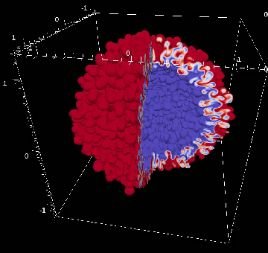
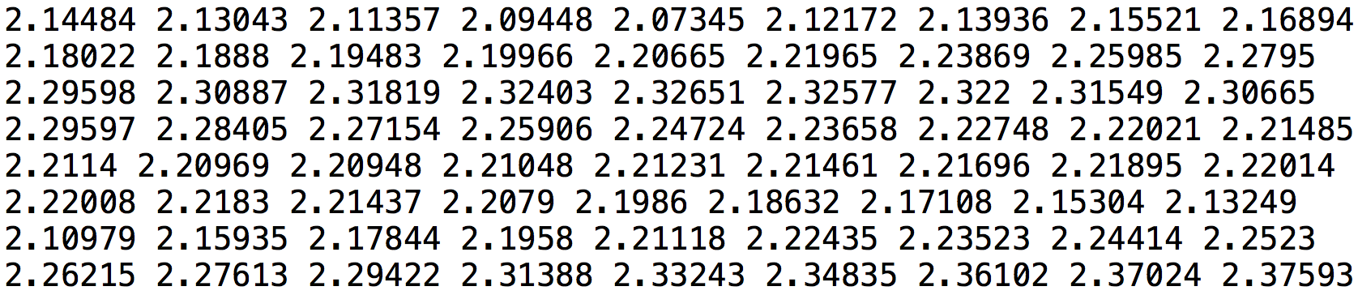
#1: Visualization is important for understanding scientific simulation data
Central actor in the scientific discovery process:
Three use cases:
Communicate
Validate
Explore
Sim
Data
Visualization Algorithms
Render
Image(s)
Display
Notes:
Visualize, analyze, and understand the data sets
Communicate examples – data analysis, images/movies
Validate examples – Data analysis, images/movies, comparison
Exploration examples – scientific discovery, debugging

Slide 12
#2: Visualization will share resources with the simulation
Traditional approach is post hoc processing
Not feasible at exascale: Compute – and thus ability to generate data – is increasing faster than I/O
Data analysis and visualization occur while simulation is running
Changes to HPC ecosystem pose challenges for visualization
Total execution time may increase since compute resources are shared
Optimizing visualization will benefit overall performance
Notes:
Traditionally, visualization is accomplished with post hoc processing… This approach will not be feasible at exascale since the rate at which simulations generate data is greatly outpacing our ability to save it.

Slide 13
Outline
Motivation
Power/Overprovisioning
Why Visualization?
Overprovisioning and Visualization
Experimental Overview
Results
Conclusion and Future Work

Slide 14
Overprovisioning and visualization merits special attention
Why? Visualization is data intensive
→ Need visualization-centric strategies to thrive in this constrained environment
Notes:
Visualization in an overprovisioned environment merits special attention. Visualization workloads are different than simulation codes, so we need visualization-centric strategies to thrive in this power constrained environment.

Slide 15
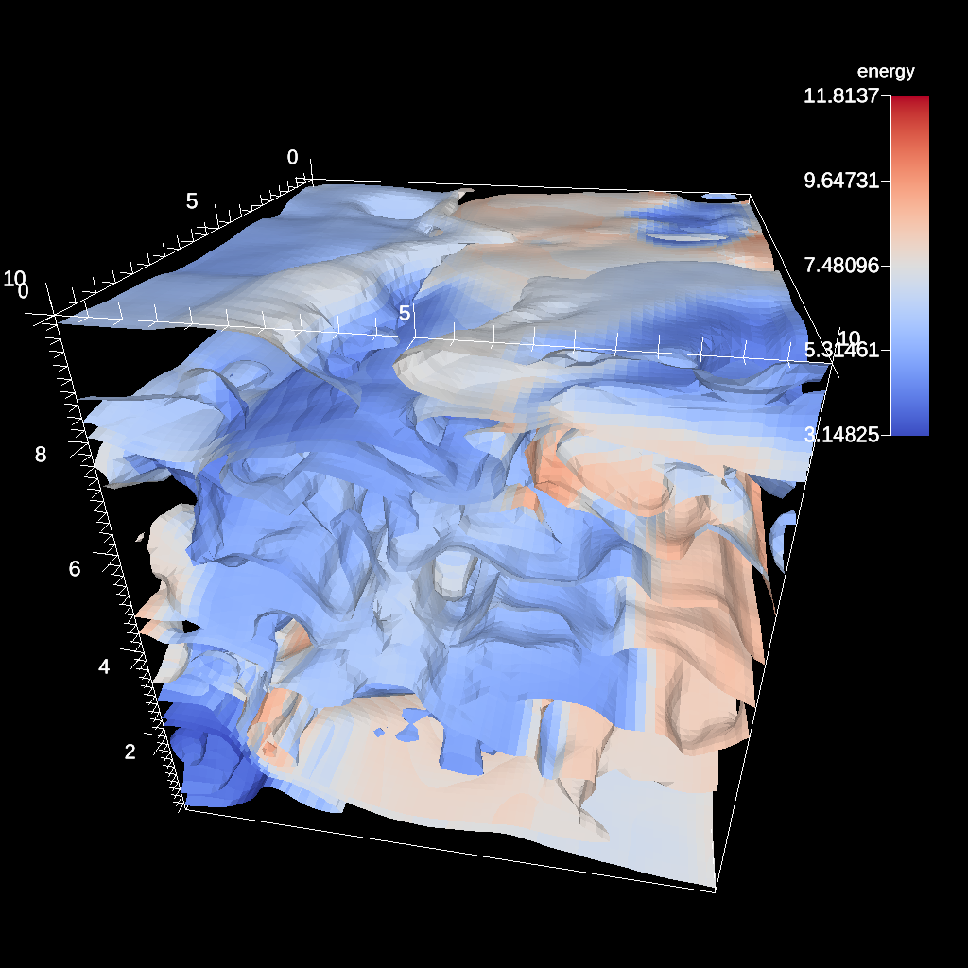
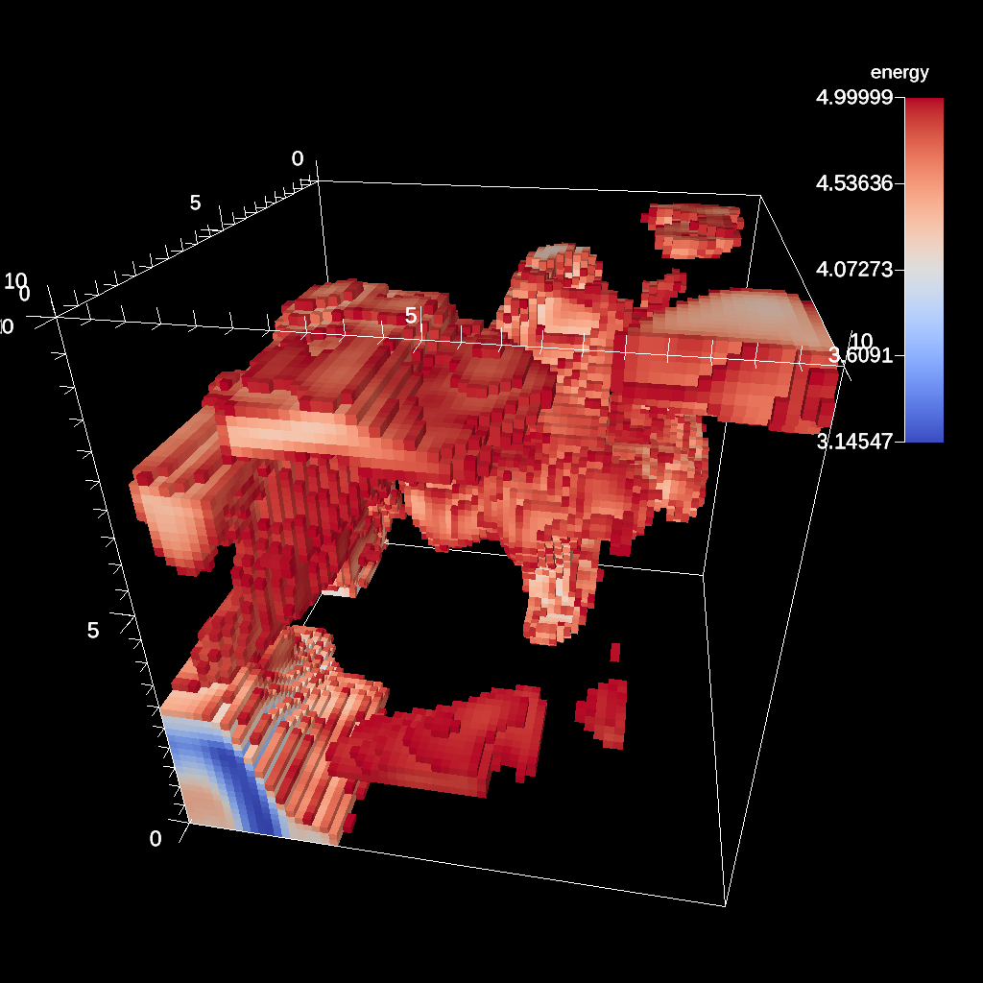
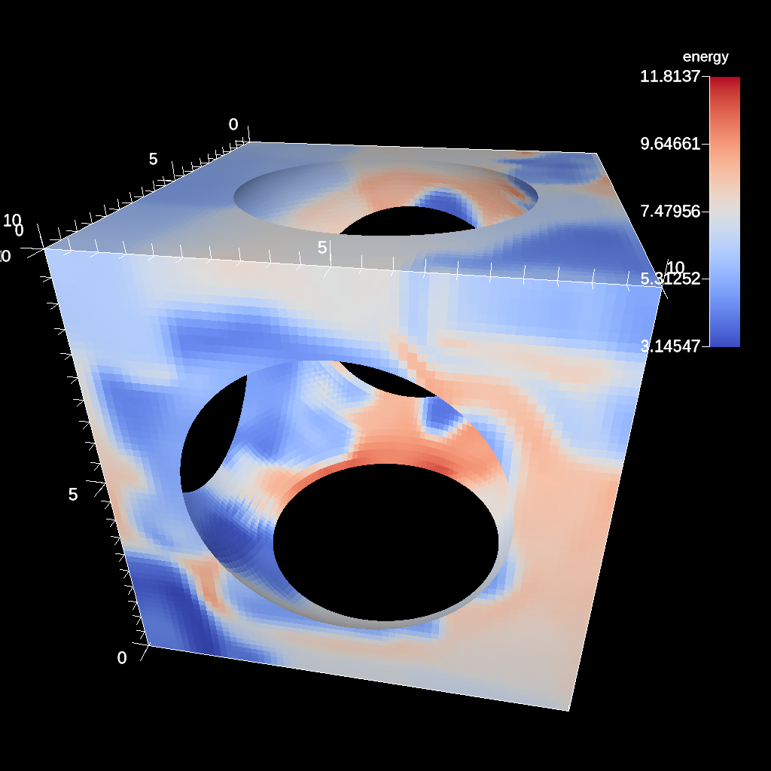
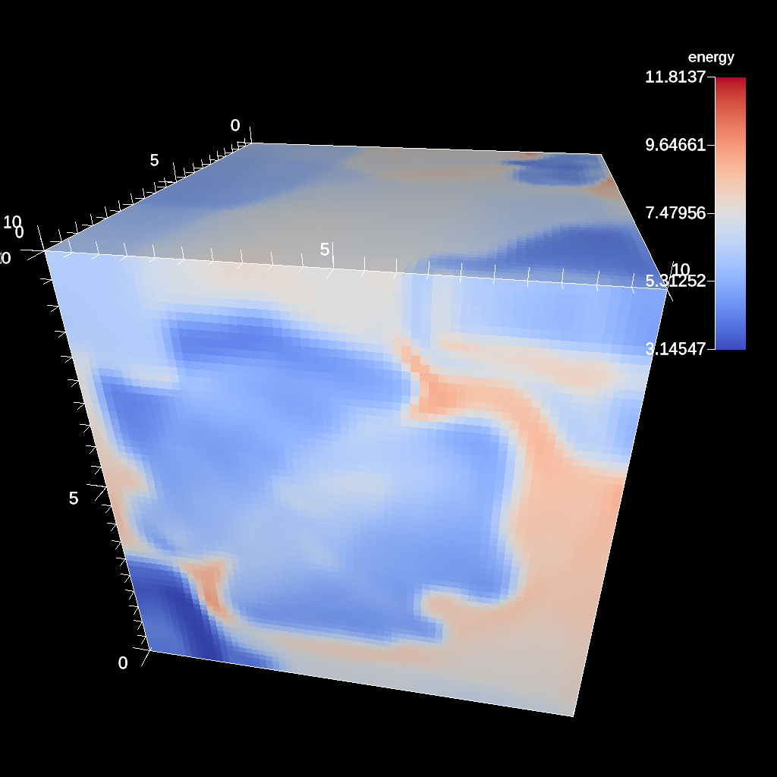
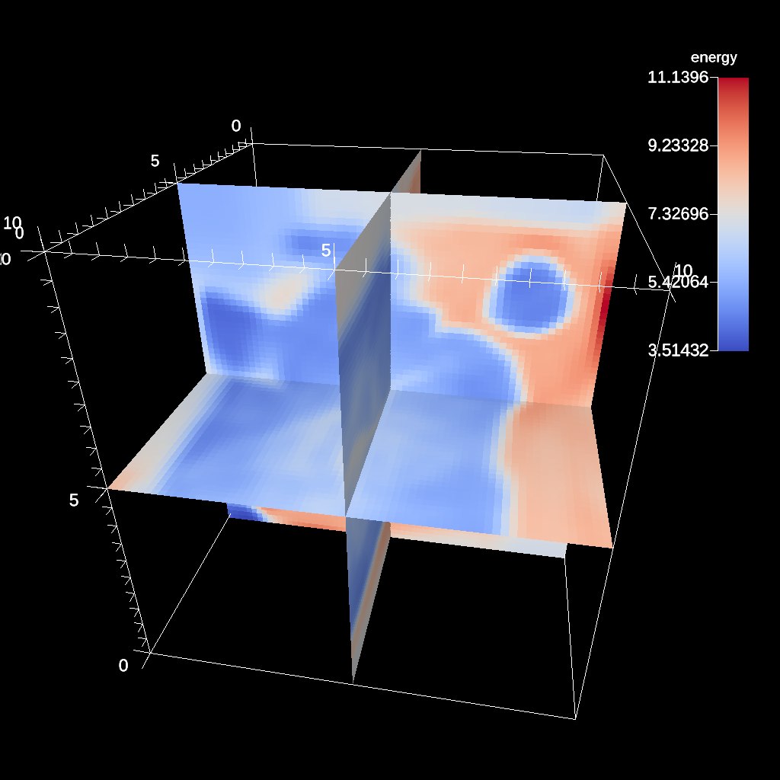
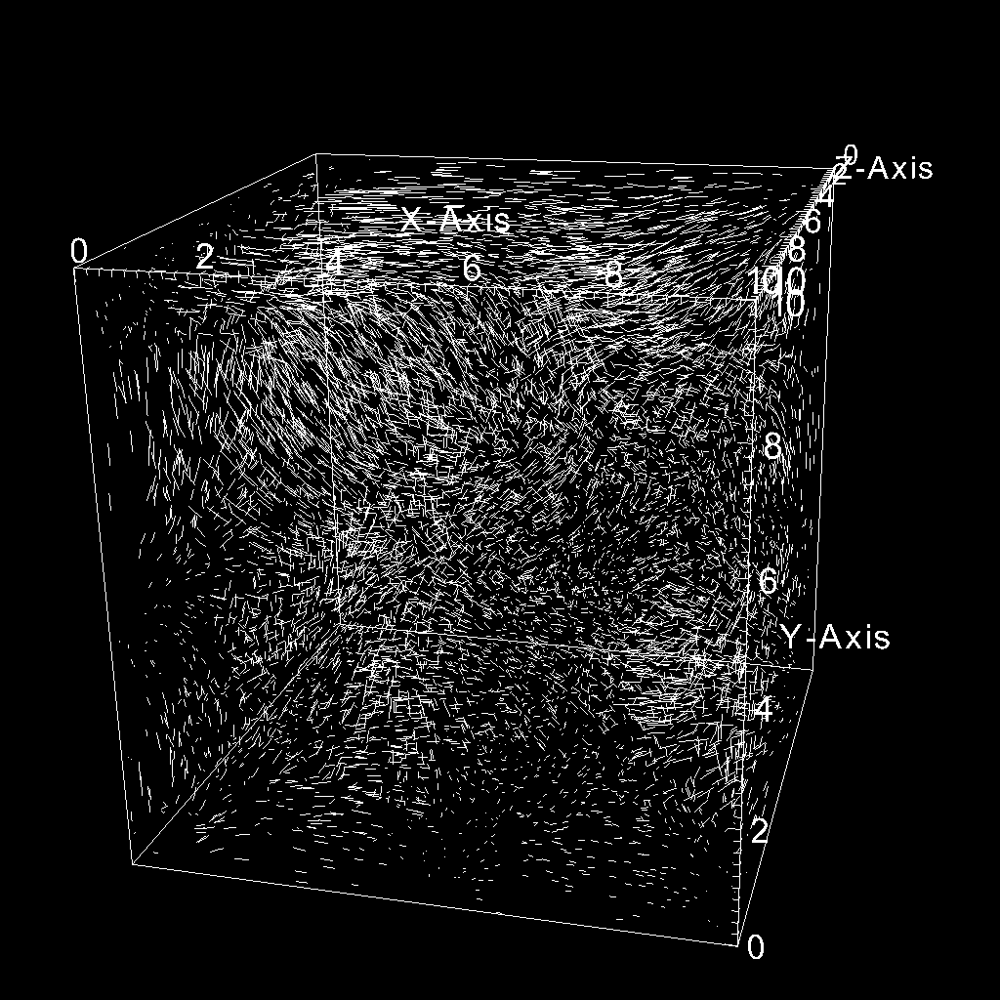
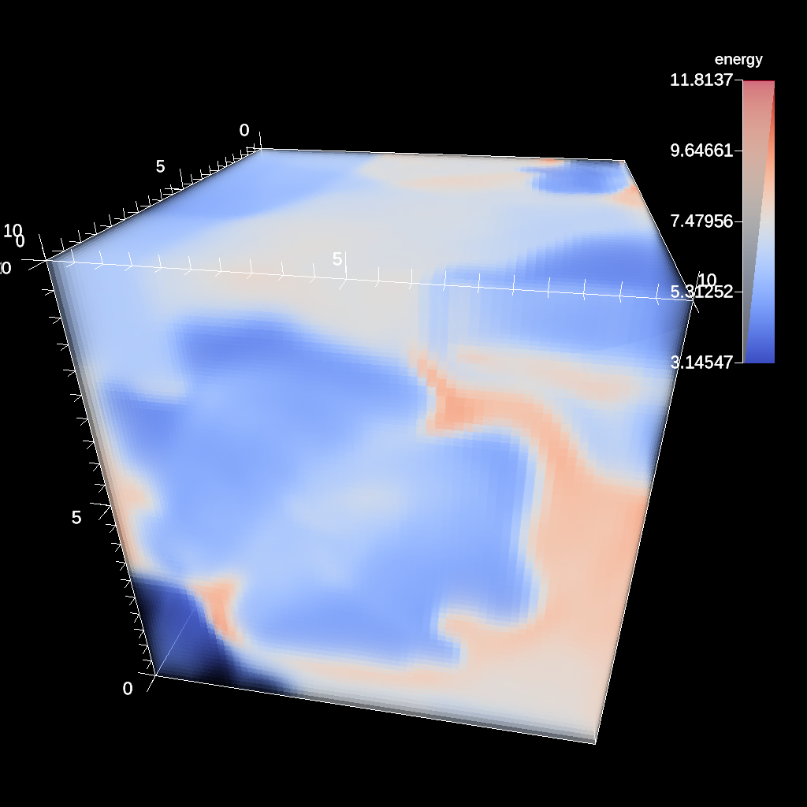
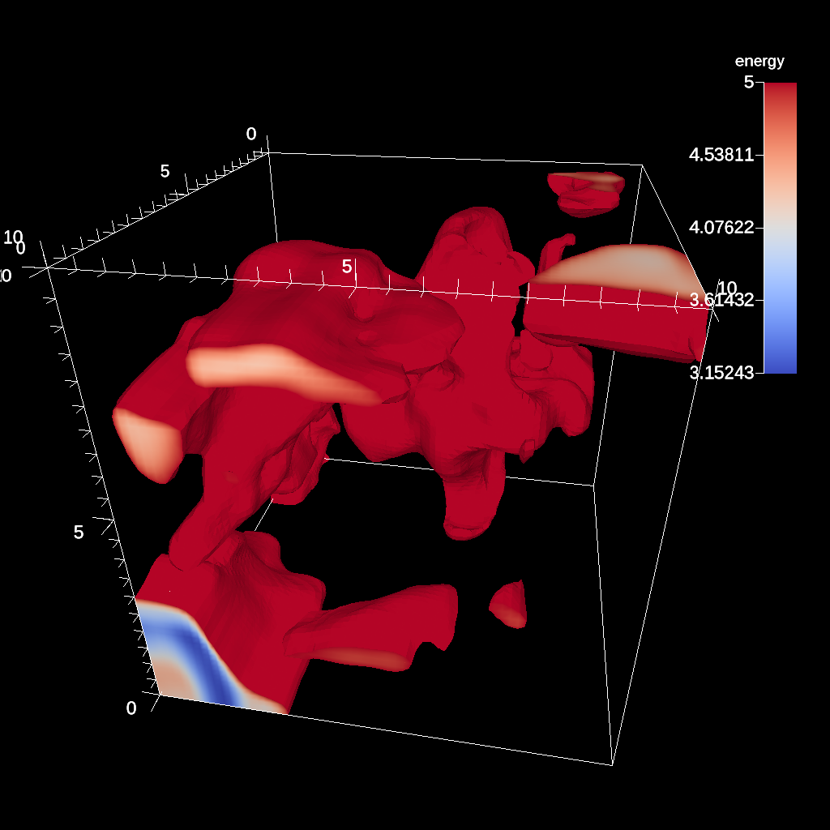
Hundreds of visualization algorithms, not practical to optimize each individually
Execution behaviors differ across algorithms
Unique configurations for each algorithm
Pipeline algorithms together
Isovalue(s),
Number of contours
Min/Max
Radius,
Center
Camera position,
Image resolution,
Number of samples
Contour
Threshold
Spherical Clip
Ray Tracing
Position,
Normal
Number of seeded particles,
Step length,
Number of steps
Camera position,
Image resolution,
Transfer function,
Number of samples
Min/Max
Our study is foundational for understanding the execution behaviors for a representative set of all algorithms under power limits.
Slice
Particle Advection
Volume Render
Isovolume
CloverLeaf 200th cycle
Notes:
Visualization workloads are different than that of the simulation, which normally have 1 key loop that can be optimized for better performance. The visualization community has hundreds of different visualization operations. The execution behaviors are highly variable across algorithms. Further complicating this space are the different configurations. In visualization, we often pipeline many of these algorithms together where the output of one operation is dependent on the data outputted from the previous operation. If want to optimize performance of the visualization pipeline, one strategy would be to optimize each algorithm individually. Since there are so many combinations, it is not practical to optimize each of these individually. Our study is foundational for understanding the execution…
There are many operations in visualization, which are highly varied (between each op)
KMoreland: However, this is not true for all visualization algorithms, many of which generate data conditionally based on the input values. With only a few exceptions, current parallel visualization functions completely ignore this load imbalance, which is considered tolerable when amortized over larger partitions.

Slide 16
Overprovisioning and visualization merits special attention
Why? Visualization is data intensive
→ Need visualization-centric strategies to thrive in this constrained environment
Research Questions
How do visualization workloads perform under power limits?
If you must run at a lower power limit, how much slowdown will you see?
Notes:
This brings us to our research questions

Slide 17
Outline
Motivation
Power/Overprovisioning
Why Visualization?
Overprovisioning and Visualization
Experimental Overview
Results
Conclusion and Future Work

Slide 18
Study Factors
Processor-level power limit
Visualization algorithm
Data set size
Single node of LLNL RZTopaz system (Intel Broadwell)
36 cores per node running at 2.1 GHz
Leverage msr-safe kernel driver to set power limit from user space
Enforce power limits with Intel’s RAPL
Acceptable limits between 120W down to 40W
https://github.com/llnl/msr-safe

Slide 19
Study Factors
Processor-level power limit
Visualization algorithm
Data set size
Contour
Threshold
Spherical Clip
Ray Tracing
Slice
Particle Advection
Volume Render
Isovolume

Slide 20
Study Factors
Processor-level power limit
Visualization algorithm
Data set size
CloverLeaf3D: Hydrodynamics proxy application
Data set sizes per node
32³, 64³, 128³, 256³
Number of cells per node range from 32K to 16M

Slide 21
Methodology
Study conducted in 3 phases
Phase 1: Vary power limit for a single visualization algorithm and data set size
Following phases varies 1 factor at a time to investigate effects
Phase 2: Vary visualization algorithm
Phase 3: Vary data set size

Slide 22
Outline
Motivation
Power/Overprovisioning
Why Visualization?
Overprovisioning and Visualization
Experimental Overview
Results
Conclusion and Future Work

Slide 23
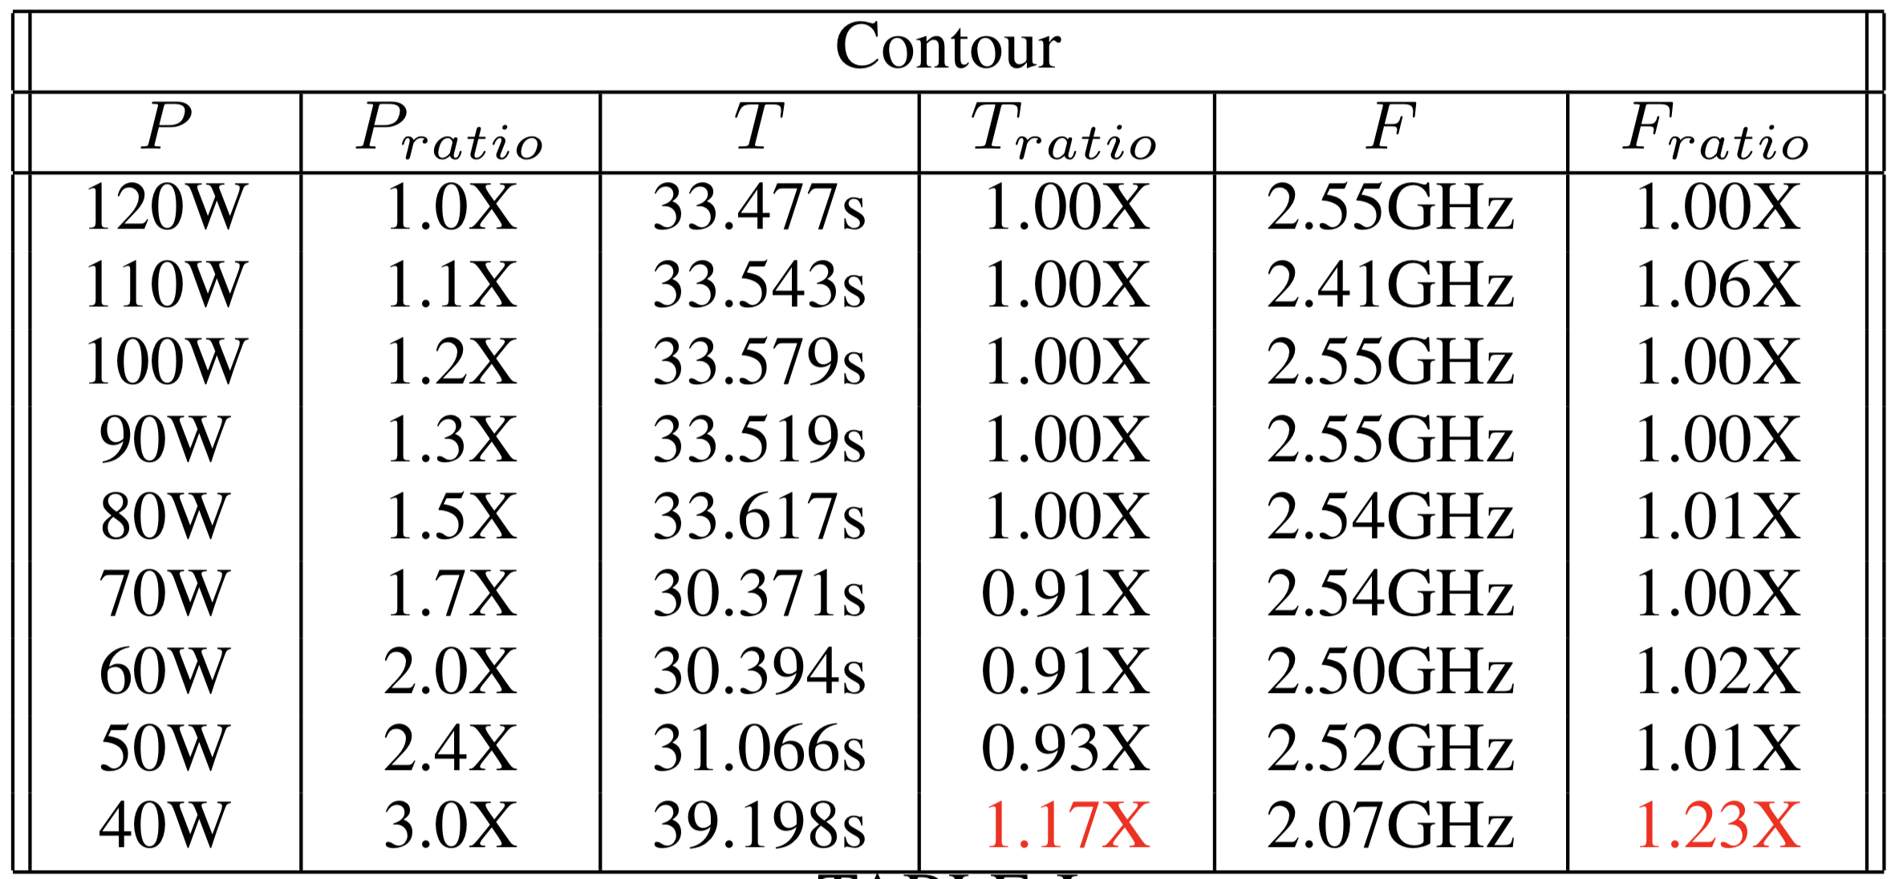
Phase 1 Results: Vary Processor-Level Power Limit
Reducing power limit by 3X:
Runtime increases by 1.2X
Frequency decreases by 1.2X
Contour algorithm does not see a slow down proportional to power limit
Favorable power savings
Notes:
P_ratio = Pdefault / Preduced
T_ratio = Treduced / Pdefault
F_ratio = F_default / Freduced

Slide 24
Changes for Phase 2
Changes: Execute all visualization algorithms under varying power limits
Goal: Investigate the data intensity of additional visualization algorithms

Slide 25


Phase 2 Results: Vary Visualization Algorithm
Power Opportunity
Performance remains constant until lowest power cap
Power Sensitive
Performance degrades relative to power cap
Compute-bound workloads
Contour
Threshold
Spherical Clip
Particle Advection
Volume Render
*Ray tracing includes 3 operations: (1) find external faces (50%), (2) build spatial acceleration structure, and (3) trace rays
Slice
Isovolume
Ray Tracing*
Notes:
What is power opportunity? These are algorithms that can achieve significant power savings without slowing down.
Ray tracing algorithm = find external faces, build acceleration structure, and trace rays

Slide 26
(cont’d) Phase 2 Results: Comparing power opportunity and power sensitive algorithms
Power Opportunity: Threshold
Iterate over the cells in data set
Remove cells that do not have values in the specified range
Simple computation dominated by loads and stores of each cell
Power Sensitive: Particle Advection
Place a massless particle at a seed location
Displace the particle according to the vector field
Result is an “integral curve” corresponding to the trajectory the particle travels – Euler, RK4, …
Threshold
Particle Advection

Slide 27
(cont’d) Phase 2 Results: Power opportunity algorithms are data intensive, while power sensitive algorithms are compute intensive
Power Opportunity
Power Opportunity

Slide 28
(cont’d) Phase 2 Results: Power opportunity algorithms are data intensive, while power sensitive algorithms are compute intensive
Power Sensitive
Power Sensitive

Slide 29
Changes for Phase 3
Changes: Execute all visualization algorithms with different data set sizes
Goal: Investigate the impacts of data set size on power and performance tradeoffs

Slide 30
Phase 3 Results: Vary Data Set Size
Cell-Centered Algorithms
data set size,
IPC
data set size,
IPC
data set size,
no change in IPC
Notes:
Volren = operation transitions to becoming more data intensive as the data set size increases (lower IPC)

Slide 31
Outline
Motivation
Power/Overprovisioning
Why Visualization?
Overprovisioning and Visualization
Experimental Overview
Results
Conclusion and Future Work

Slide 32
Takeaways inform how visualization algorithms can adapt to imposed power limits
VTK-m contour implementation is sufficiently data intensive to avoid a significant slowdown when the power limit is reduced
Most algorithms consume low amounts of power, providing opportunities for energy/power savings (e.g., data intensive)
Tradeoffs become more favorable with a smaller data set size per node
Future work: Integrate these learnings into a power-aware runtime system, such that more informed decisions can be made about how to allocate power in an in situ workflow
Notes:
VTK impelentation of isosurfacing, which performs isosurfacing in a general way – works on many cell types, higher order elements
Designed for extensibility, but comes with performance tradeoffs

Slide 33
Thank you!
VTK-m contour implementation is sufficiently data intensive to avoid a significant slowdown when the power limit is reduced
Most algorithms consume low amounts of power, providing opportunities for energy/power savings (e.g., data intensive)
Tradeoffs become more favorable with a smaller data set size per node
Future work: Integrate these learnings into a power-aware runtime system, such that more informed decisions can be made about how to allocate power in an in situ workflow
“Power and Performance Tradeoffs for Visualization Algorithms”
Stephanie (Labasan) Brink (brink2@llnl.gov)

